Slide 1
A presentation on the analysis of customer churn in MTN
Prepared by: Chinenye Alexandra okechukwu

Slide 2
Table of content
Executive Summary
Data Description
Methodology
Analysis
Recommendation & Conclusion.

Slide 3
Executive Summary
Customer churn is one of the biggest concerns for telecom companies, especially in competitive markets like Nigeria.
This project analyses customer behaviour to understand churn and retention patterns of MTN customers.

Slide 4
Data Description
This dataset contains 974 rows of customer entries and the following columns:
Customer ID: A unique identifier assigned to each customer. May appear more than once if the customer owns multiple devices.
Full Name: The full name of the customer. Names reflect a balance across Nigerian ethnicities and regions.
Date of Purchase: Month and year the device or plan was purchased. All entries are from 2025.
Age: Age of the customer (between 16 and 80). Rules apply to age and purchasing behavior.
State: Nigerian state where the customer resides, including the FCT.
MTN Device: Device purchased by the customer. Includes: Mobile SIM Card, Broadband MiFi, 4G Router, 5G Broadband Router.
Gender: Gender of the customer (Male or Female).
Satisfaction Rate: A score from 0 to 5 reflecting the customer’s satisfaction.
Customer Review: Categorical review of the customer experience: Poor, Fair, Good, Very Good, Excellent.
Customer Tenure in months: How long the customer has been subscribed (in months).
Subscription Plan: The name of the MTN data plan purchased (e.g., 60GB Monthly Broadband Plan, 7GB Monthly Plan, etc.).
Unit Price: Cost of the data plan in Nigerian Naira (₦).
Data Usage: Estimated data usage in gigabytes (GB). Not necessarily equal to the plan size—it reflects usage behavior.
Number of Times Purchased: How many times the plan was purchased within the month (simulates customer consumption rate).
Total Revenue: Total amount spent by the customer (calculated as Unit Price × Number of Times Purchased).
Customer Churn Status: Indicates whether the customer has churned (Yes) or is still active (No).
Reasons for Churn: If churned, this field shows the reason (e.g., Poor Network, Relocation, High Call Tariffs, etc.). Empty for active customers

Slide 5
Methodology
Inspected the dataset using Microsoft Excel in-built functions.
Conducted analysis using tools like Power Query and DAX functions.
Visualized trends and distributions.
Summarized insights and built presentations in PowerPoint.

Slide 6

This analysis seeks to:
Analysis
Understand
Understand the variation of retention rate and churn rate amongst different age groups.
Find out
Find out how gender affects retention rate and churn rate.
Discover
Discover underlying reasons for customer churn.
Recognize
Recognize the impact of customer tenure on retention and churn.
Get
Get the distribution of customers who have churned across various locations.

Slide 7

Based on the dataset:
The total number of customers who churned are 284.
The number of customers who remained are 690
The total revenue for all the customers is 199348200 naira.
We have 479 males across the dataset and 495 females.
Average satisfaction rate is 2.95.

Slide 8
Understand the variation of retention rate and churn rate amongst different age groups.
Older customers have the highest churn rates—particularly in the "Old" (219 churned) and "Senior Adult" (127 churned) categories.
Young customers show better retention—Teenagers (20 churned, 6 retained) and Youth (107 churned, 54 retained) have a relatively stronger balance of retained customers compared to older groups.
Adult & Middle-Aged customers have moderate churn levels, with churn numbers close to 100, but retention numbers still lower.

Slide 9
Find out how gender affects retention rate and churn rate.
One key takeaway is that the number of retained customers is identical for both genders—345 each. This suggests that the retention strategies in place are equally effective across male and female customers.
However, customer churn is slightly higher among females (150) compared to males (134). This means that more female customers are discontinuing the service. While the difference isn’t drastic, it could indicate underlying factors that influence female customers' decisions to leave. Investigating the reasons behind this gap—perhaps through surveys or customer feedback—could provide valuable insights to reduce female churn and improve overall retention.

Slide 10
Discover underlying reasons for customer churn.
Customers leave due to high costs, poor network service, and inadequate customer support. Competitive offers attract them elsewhere, while fast data depletion frustrates users. Some move away, making churn unavoidable. To retain customers, improving affordability, service reliability, and support quality is crucial

Slide 11
Recognize the impact of customer tenure on retention and churn.
Retention Rate: 34 customers remained active, indicating a stable customer base.
Churn Rate: 29 customers left, showing a significant drop-off that could signal areas for improvement.
Implication: The near-even split suggests that tenure alone may not be the strongest factor influencing customer loyalty—other aspects like service quality, engagement, or external market forces might be at play.

Slide 12
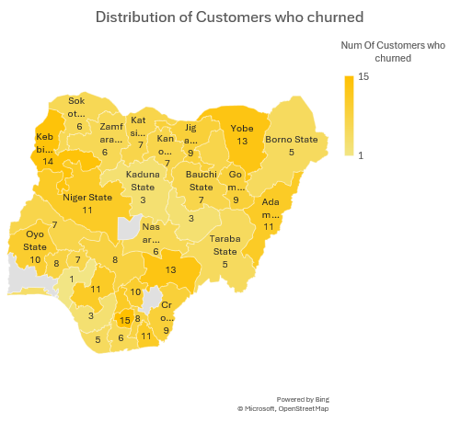
Get the distribution of customers who have churned across various locations.
Highest Churn: Imo and Abuja (FCT) have the highest churn rate, with 15 customers each.
Lowest Churn: Ondo recorded the lowest churn, with just 1 customer, followed by Delta.
Notable Patterns: Several states, including Adamawa, Akwa Ibom, Anambra, and Edo, all have 11 churned customers, indicating potential shared factors influencing their churn rates.

Slide 13
Recommendations & Conclusions
Focus retention efforts on the "Old" age group, as it has the highest number of customers who churned.
Enhance customer retention strategies, especially for female customers, as their churn rate is higher despite equal retention numbers across genders.
Focus on improving customer service and offering competitive deals to reduce churn, as these are the top reasons for customer departure according to the analysis.

Slide 14

Thank You!

